Slide 1
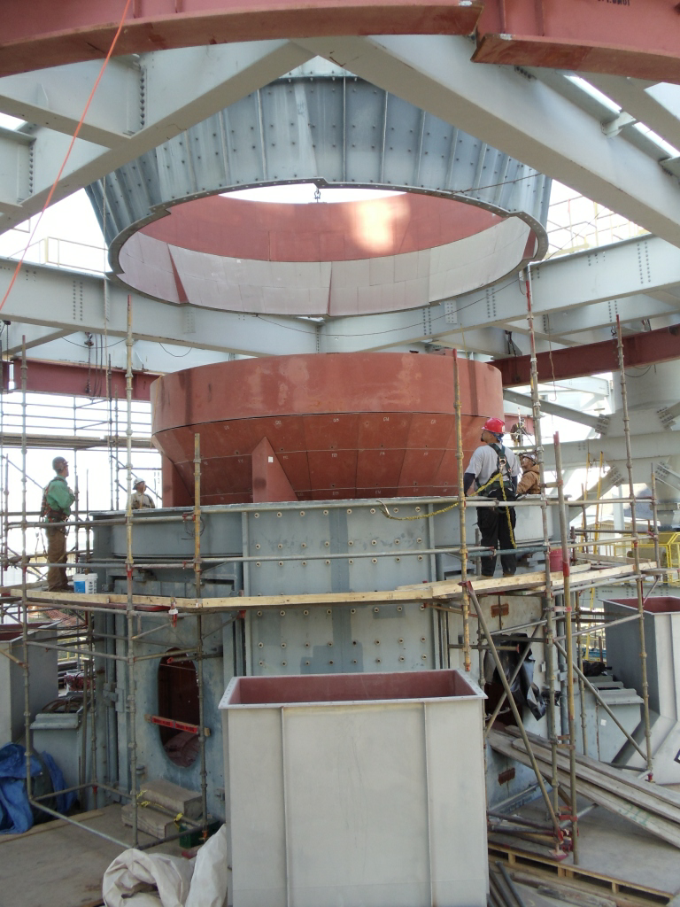
CEMENT PRODUCTION – TXI
Project: TXI (Texas Industries, Inc), Hunter, TX
New Cement Production Line
Scope: Complete construction of new line
Complete foundations and steel
Complete mechanical and piping
Complete electrical
Complete equipment installation Start-up support
Project Equipment:
Storage dome
Raw mill
Pyro/Kiln area
Material Handling
Storage silos
Other
Raw Mill lower housing
being set

Slide 2
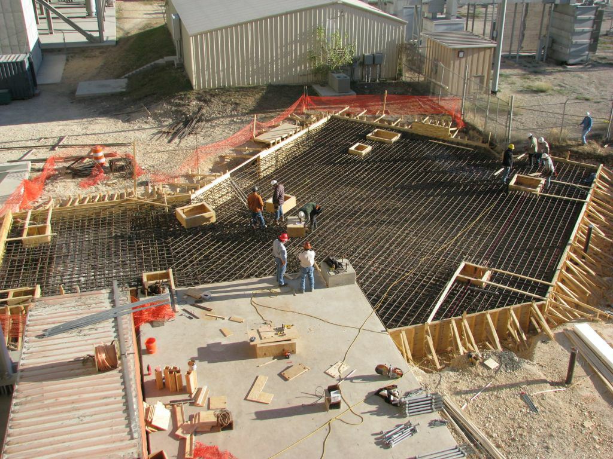
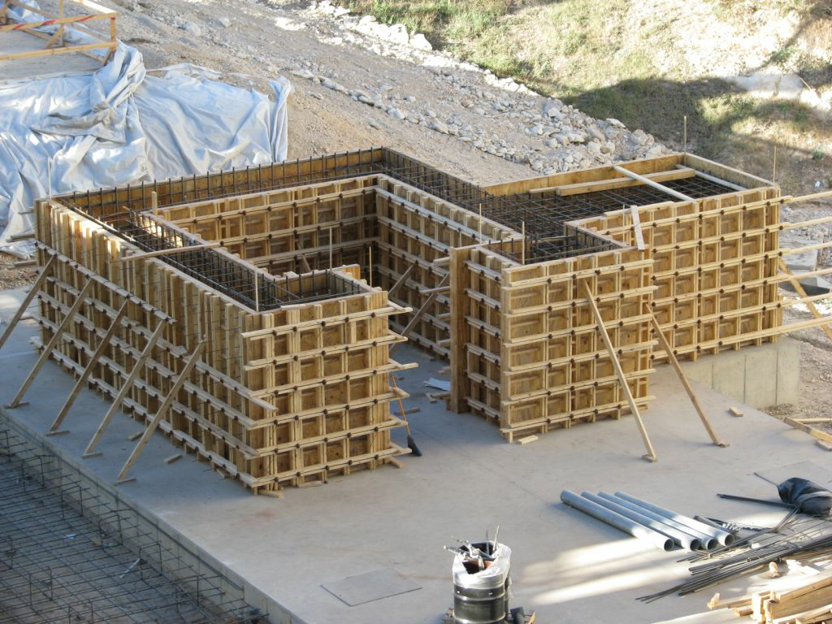
CEMENT PRODUCTION – TXI, HUNTER TX
Concrete Foundations
Alkali By Pass Foundation
Raw Mill Fan Foundation

Slide 3
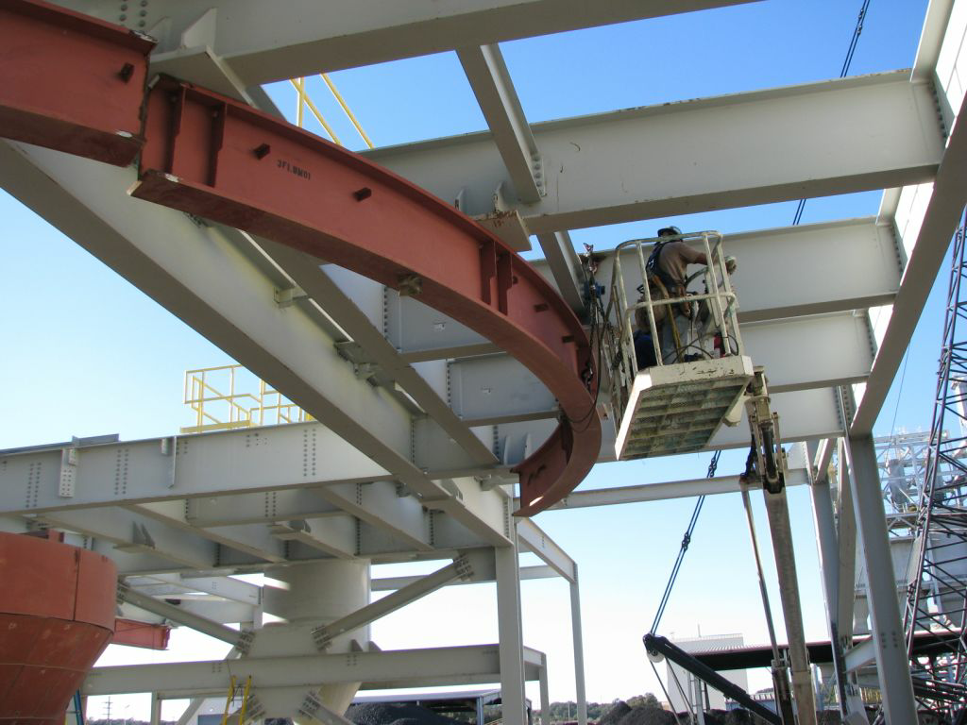
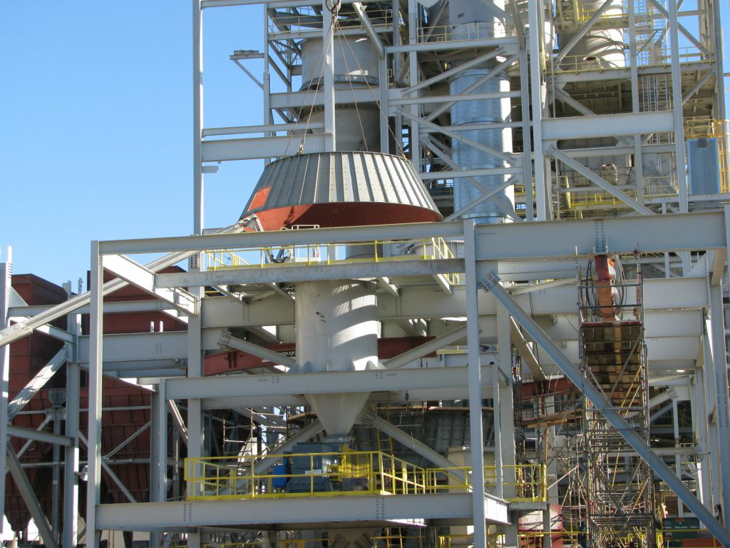
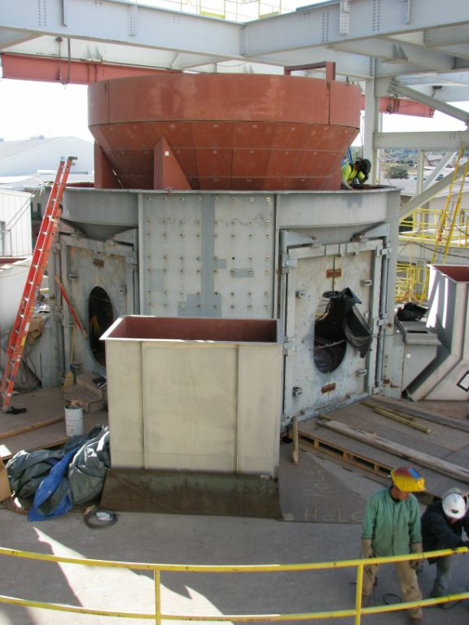
CEMENT PRODUCTION – TXI, HUNTER TX
Equipment Setting
(Raw Mill)
Raw Mill Monorail
Raw Mill Upper Housing
Raw Mill Cone

